Slide 1
UNITED INTERNATIONAL UNIVERSITY
PROJECT TITLE
View Parking Scenario
Name: Fahmida Akther
Id: 011 142 142

Slide 2
INTRODUCTION
It is a viewing scenario based application
This is a place for people’s daily needs
When people go out of the house, they use the road
Also people go to the garden with the family to make their mind fresh

Slide 3
FEATURES OF THIS PROJECT
Human
Car
Chair and table
Field
Bench
Sky
Rocking
Lamp post

Slide 4
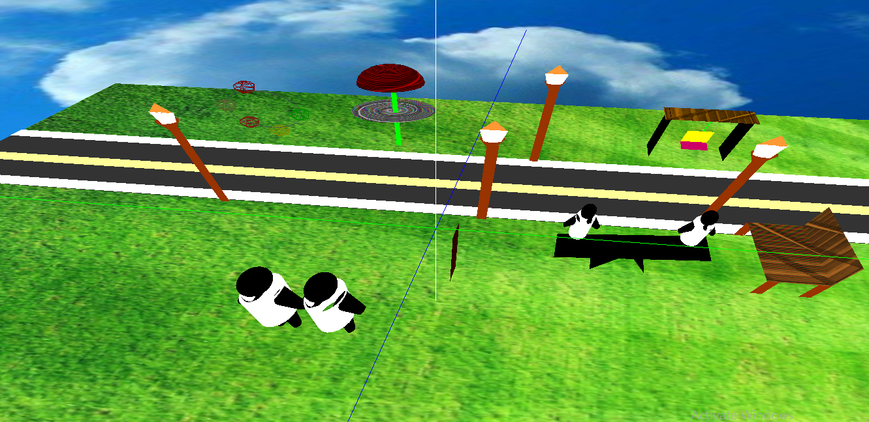
SOME PICTURES OF MY PROJECT

Slide 5
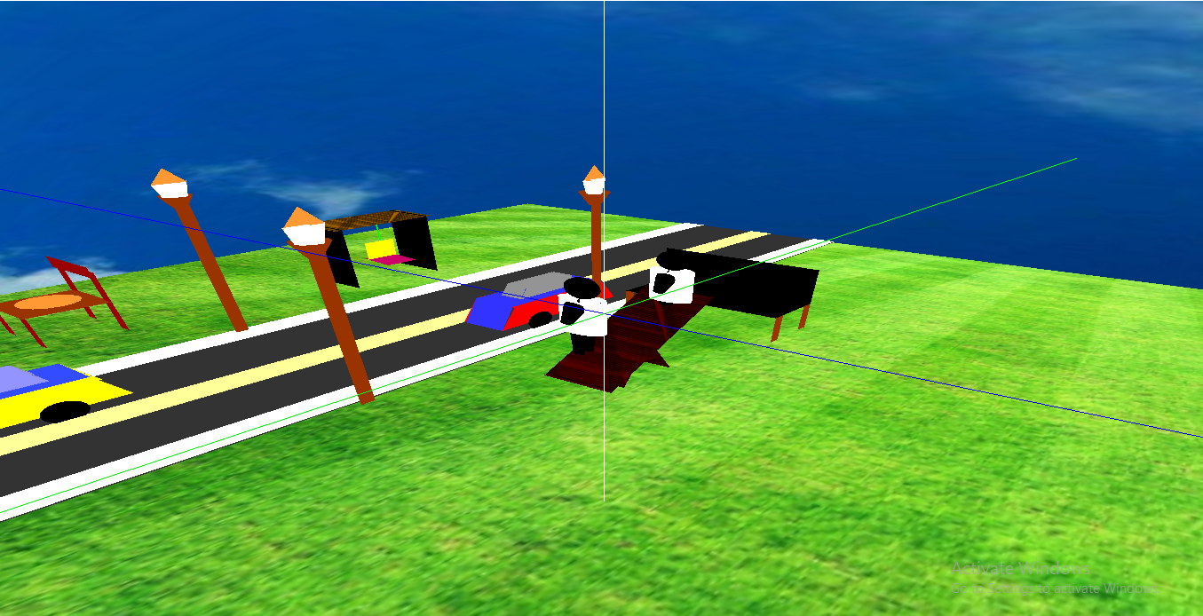

Slide 6
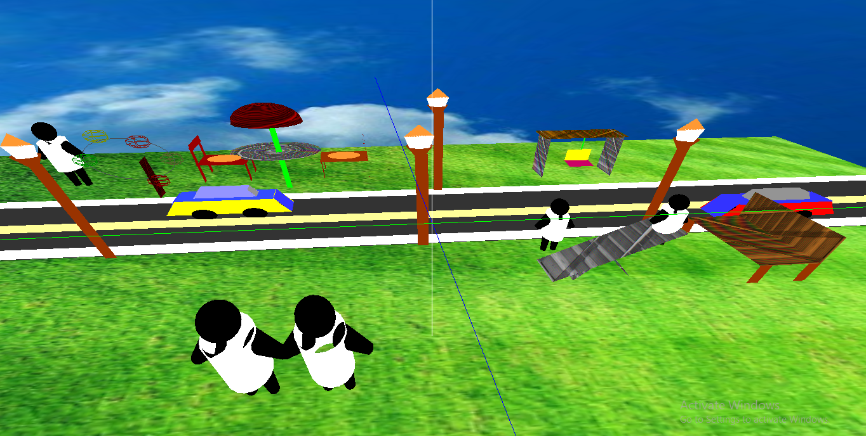

Slide 7
THANK YOU ☺

